Slide 1
EFFICIENCY+ Enhancing Operational Efficiency in Clinical Trials
ASA Biopharmaceutical Section /// Scientific Working Group (SWG)
July 10, 2025
Mission
Enhance operational efficiency in clinical trials through statistical innovation and cross-functional collaborative research

Slide 2
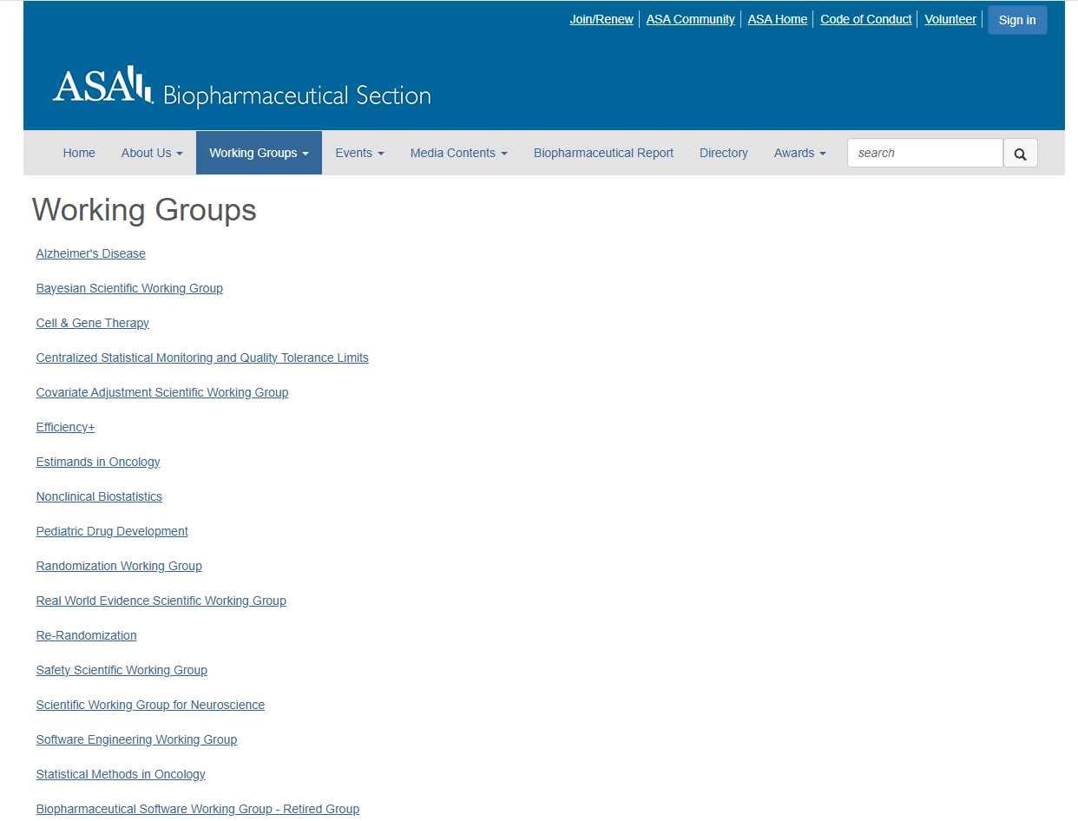
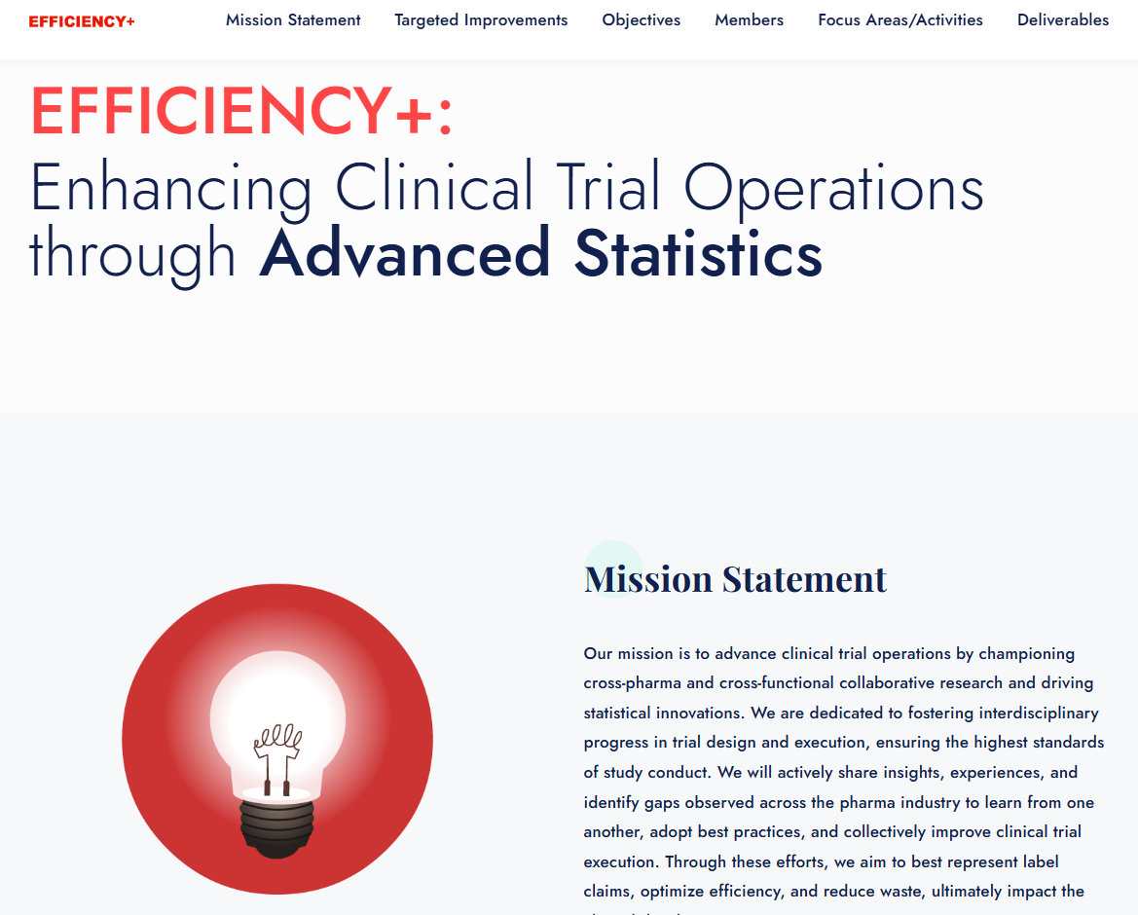
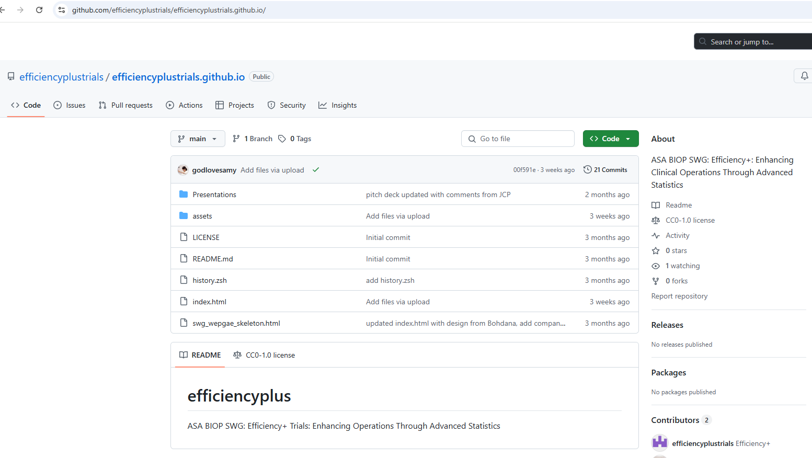
New ASA BIOP SWG

Slide 3
Initial Targets for SWG Membership
Initial Member Profiles
Statisticians
Clinical operations professionals
Data scientists
Desired expertise
Bayesian modeling
Predictive modeling, AI/ML
Clinical trial simulations
Data visualization
Data science and software tools development
Clinical drug supply optimization

Slide 4
Individuals Who Expressed Interest for Membership
Who | Sponsor | Email | Interests
Fei Chen (co-chair) | JJIM | fchen6@its.jnj.com | Regulatory
Bohdana Ratitch (co-chair) | Bayer | bohdana.ratitch@bayer.com | Representativeness /ML
Xin Wang | Abbvie | xin.wang@abbvie.com | Site selection
Vlad Anisimov | Amgen | vanisimo@amgen.com | Methodology
Christi Kleoudis | AstraZeneca | christi.kleoudis@astrazeneca.com
Andrew Chen | Bayer | andrew.chen@bayer.com | Site selection and assessment
Clara Cali Mella | Bayer | clara.calimella@bayer.com | Recruitment monitoring
Tobias Straubinger | Bayer | tobias.straubinger@bayer.com | Forecasting
Kaifeng Lu | Beonemed | kaifeng.lu@beonemed.com | Drug demand forecasting
Inna Perevozskaya | BMS | inna.perevozskaya@bms.com | Methodology
Palanikumar Ravindran | BMS | palanikumar.ravindran@bms.com | AI/ML/Viz
Zhuoxin Yu | BMS | zhuoxin.yu@bms.com | Enrollment and retention monitoring, DHTs
Haoyu Wang | BMS | haoyu.wang2@bms.com
Kyle Wathen | Cytel | kyle.wathen@cytel.com | Software
Robert Abugov | FDA | Robert.Abugov@fda.hhs.gov
Bhargava Reddy | JJIM | breddy1@ITS.JNJ.com | Operations
Forrest Williamson | Lilly | forrest_williamson@lilly.com | Pediatric
Jun Xing | Sanofi | Jun.Xing@sanofi.com

Slide 5
Challenges in Clinical Operations and Potential Benefits
Challenges
Potential Benefits
Delays in drug development
High drug development costs
Unequal patient access to clinical trials
Accelerated timelines for treatment availability
Enhanced trial data quality and integrity
Reduced burdens on patients and investigators
Improved generalizability of trial results
Lower development costs

Slide 6
Primary Goals of Efficiency+
Create a collaborative platform for statisticians, clinical operational experts, and regulators
Facilitate the exchange of insights, experiences, and best practices
Identify, evaluate, develop, and promote statistical methods and operational strategies to improve the efficiency of clinical trial execution, including:
Leveraging innovative methodologies such as Bayesian modeling, Data Science and AI/ML, clinical trial simulation, and data visualization
Leveraging real-world and clinical trial data

Slide 7
Proposed Focus Areas
Site selection and performance modeling using data-driven approaches
Ensuring representativeness of trial populations and generalizability
Recruitment monitoring and forecasting: best practices and tools
Clinical drug supply optimization for just-in-time supply models
Strategic data collection and analysis planning for alignment with Target Product Profile
Patient engagement: and best practices for evaluating participant satisfaction
Operational efficiencies in non-traditional trial settings (e.g., DCTs, PCTs)
Analysis implementation efficiency

Slide 8
Activities and Timeline
Year 1
Literature review
Year 2
Develop and apply methodologies
Year 3
Publish findings
Identify key inefficiencies
Summarize existing methodologies and tools
Propose methodological improvements
Conduct case studies
Develop recommendations
Present at conferences
Promote best practices across the industry
Explore potential collaborations with other related SWGs

Slide 9
Workstreams
Literature review and gap analysis in (some of) the proposed focus areas - see slide 6
Methodology – facilitation and development - establishing collaborations, addressing identified gaps, case studies
Considering relevant regulatory aspects

Slide 10
Dissemination and Outreach
Maintaining SWG web page
Conferences, webinars
Journal articles, white papers
Special issues, e.g., Journal of Biopharmaceutical Statistics, Statistics in Medicine
Amstat newsletters, social media channels

Slide 11
Current Status
ASA BIOP SWG main page
Efficiency+ Github Repo
Efficiency+ web page (published via Github)
BASS 2025 workshop
ENAR 2026 invited session
IBC 2026

Slide 12
Next Steps and Logistics
Form workstreams around focus areas
Maintain web-site and social media presence
Frequency of general meetings
Way of working (Github?)

Slide 13
Existing SWGs – for awareness and potential collaborations
Centralized Statistical Monitoring and Quality Tolerance Limit SWG: Focuses on statistical thresholds and site performance monitoring
AI/ML SWG: Applies AI and machine learning for predictive modeling in recruitment and site selection
Software Engineering SWG: Enhances software development processes impacting trial efficiency
Bayesian SWG: Specializes in Bayesian methodologies for trial design and data analysis

